Slide 1
WindTrue: Workshop on sensitivity analysis using UQLab
CWI Amsterdam
Jan 13, 2020
Prashant Kumar
Benjamin Sanderse
Vinit Dighe

Slide 2
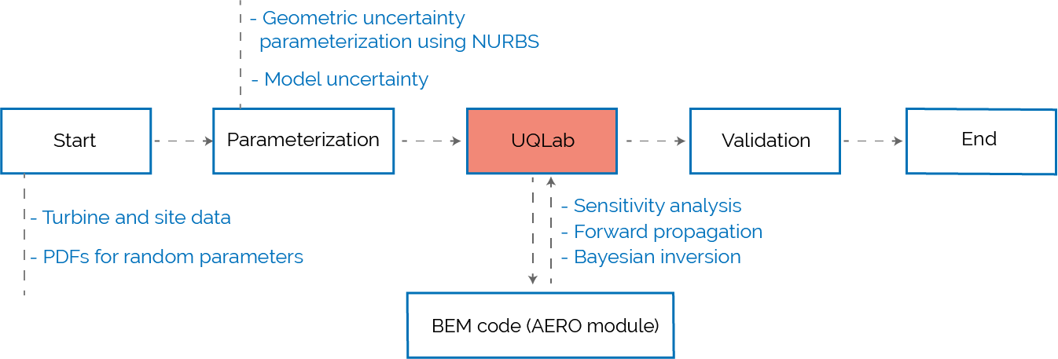
Workflow

Slide 3
Background material
User manual of our workflow: on Git repository.
UQLab examples and user manual: https://www.uqlab.com/

Slide 4
Installation
Clone from the git repository: https://scm.cwi.nl.
Use a git GUI, or command line: git clone https://username@scm.cwi.nl/SC/windtrue
Or simply download the files
Modify “config.m” file that defines the path to your UQLab installation
Example: UQLab_path = ‘C:\User\UQLab\’
Go to the directory ‘\windtrue\sensitivity_analysis\cases\Ishigami\’ and run ‘UQLab_simple_test’ from Matlab command window

Slide 5
Part I Theory and UQLab intro

Slide 6
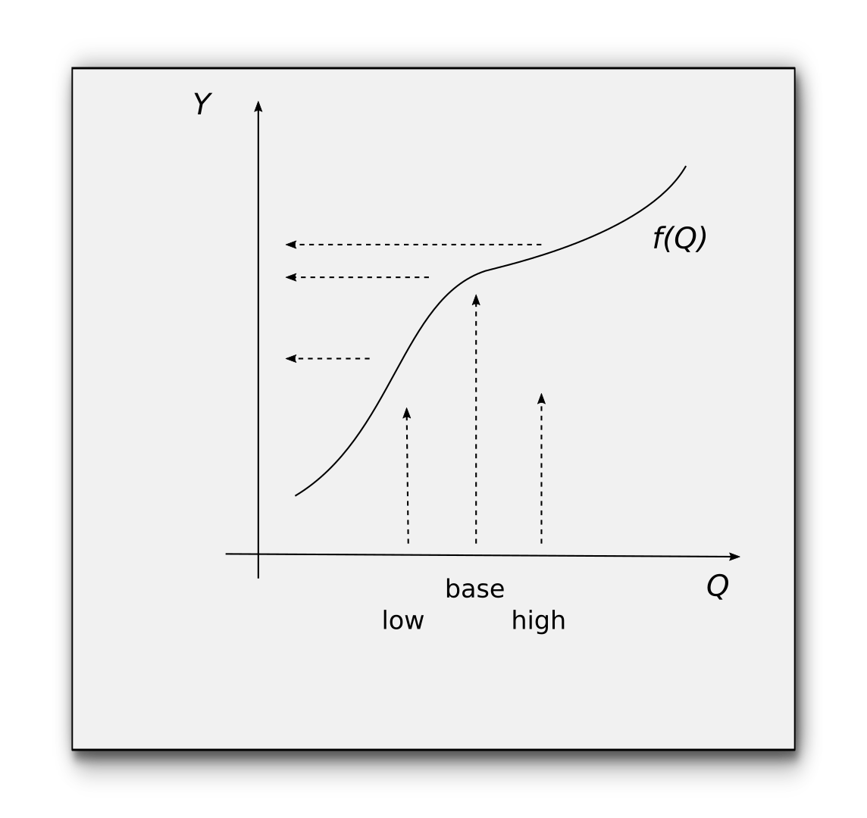
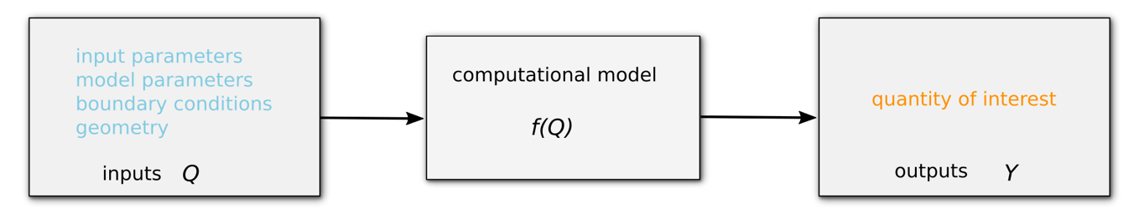
Propagation
Power
Fatigue loads
Moments
…
Inflow conditions
BEM parameters
Blade geometry
...

Slide 7
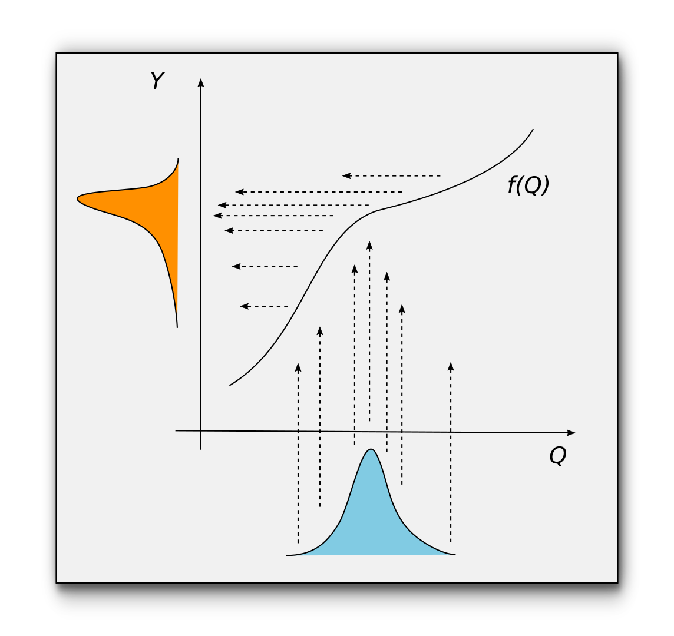
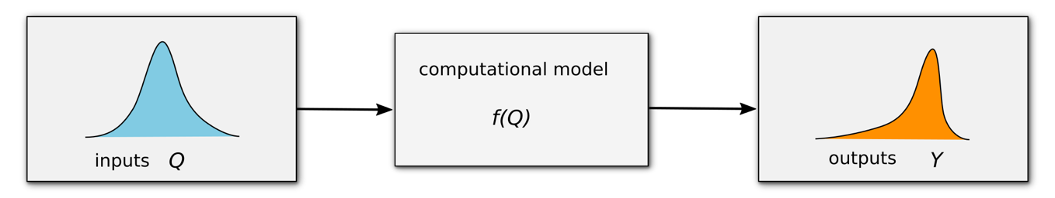
Propagation

Slide 8
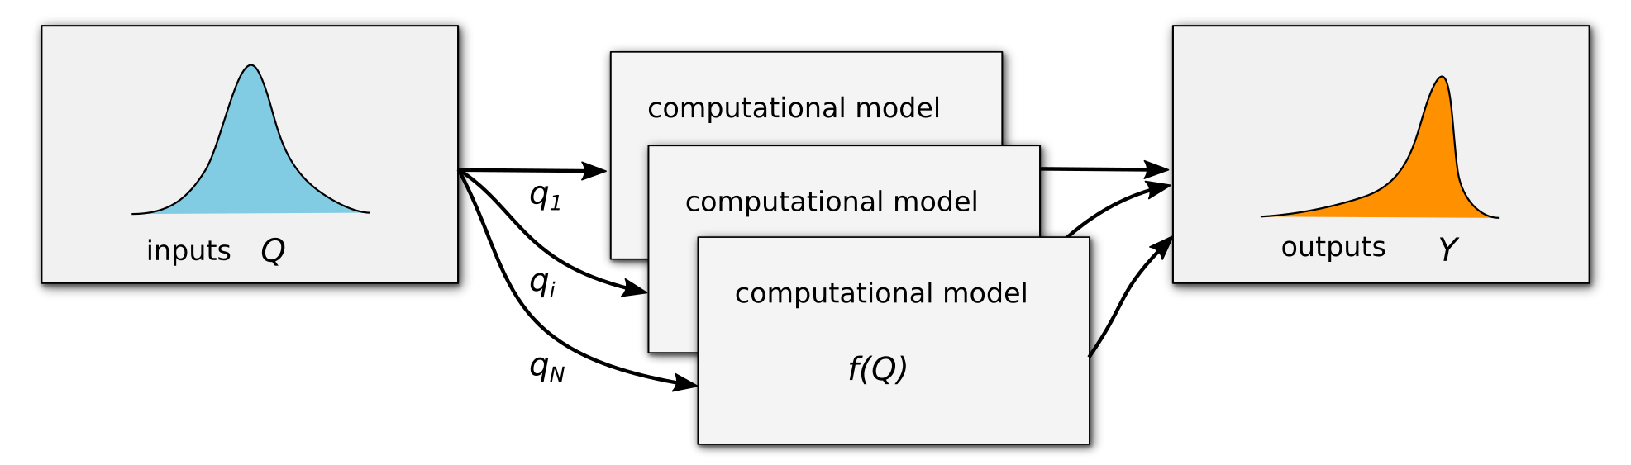
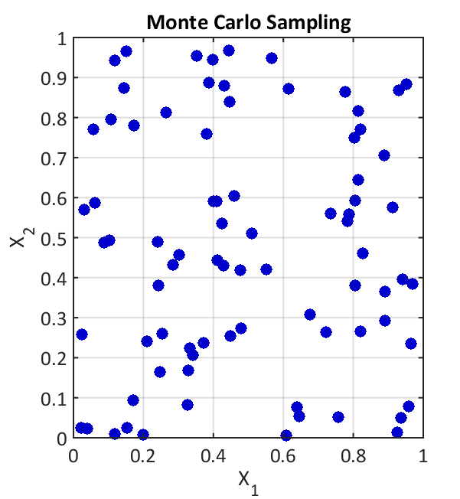
Monte Carlo
random samples q_{i}
with equal weights
slow convergence

Slide 9
Surrogate models
Full model response
Response surface
Polynomials
Radial basis functions
Gaussian processes
Neural networks

Slide 10
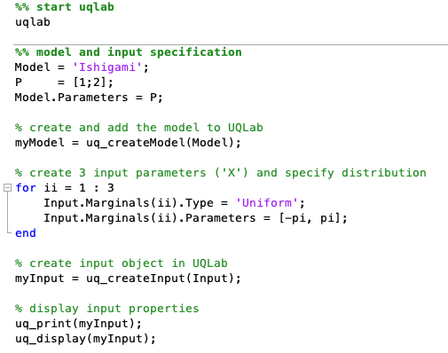
UQLab basics
Start UQLab
Define model
Define inputs and their distribution (marginals)

Slide 11
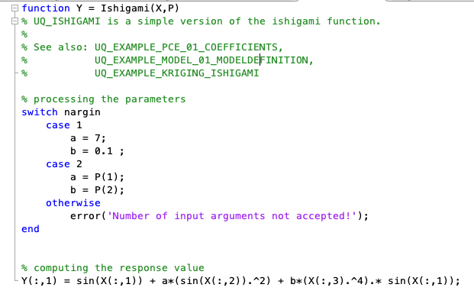
UQLab basics
Example: Ishigami function in ‘cases/Ishigami/UQLab_simple_test.m’

Slide 12
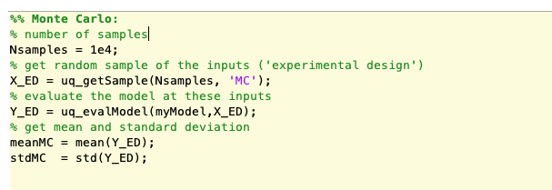
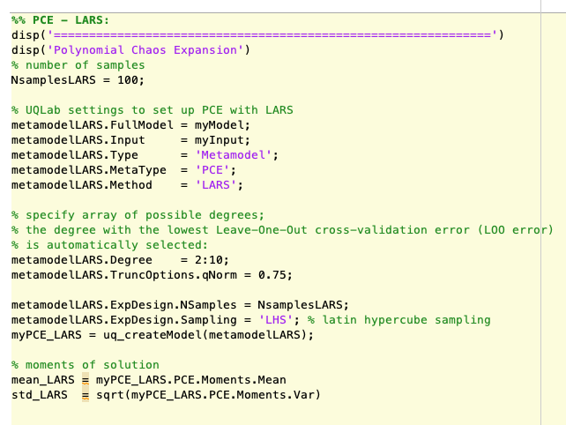
UQLab basics
4. Monte Carlo analysis
5. Postprocessing
4. Surrogate model analysis
5. Postprocessing

Slide 13
UQLab basics
===================================
Monte Carlo sampling
mean_MC = 3.044257935773240
std_MC = 3.612460899909606
======================================
Polynomial Chaos Expansion
mean_LARS = 3.500332869036883
std_LARS = 3.718773696197107

Slide 14
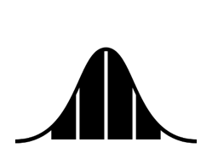
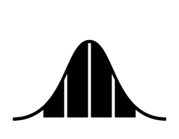

Sensitivity (Sobol’) analysis
Global sensitivity analysis
Decompose variance of output in terms of variance of inputs
Sobol’ indices (first order)

Slide 15
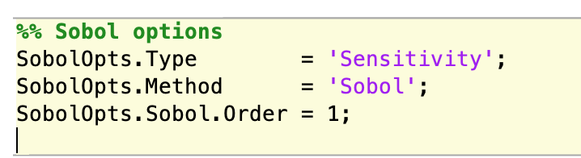
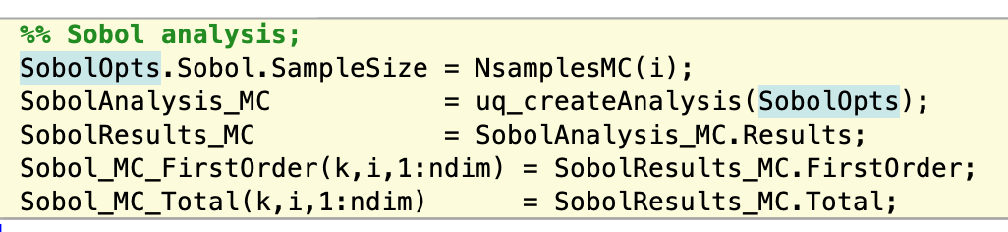
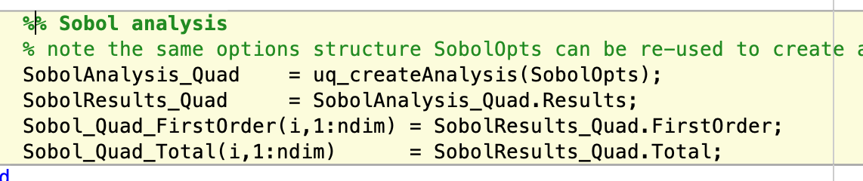
UQLab sensitivity
Monte Carlo analysis
Surrogate model analysis

Slide 16
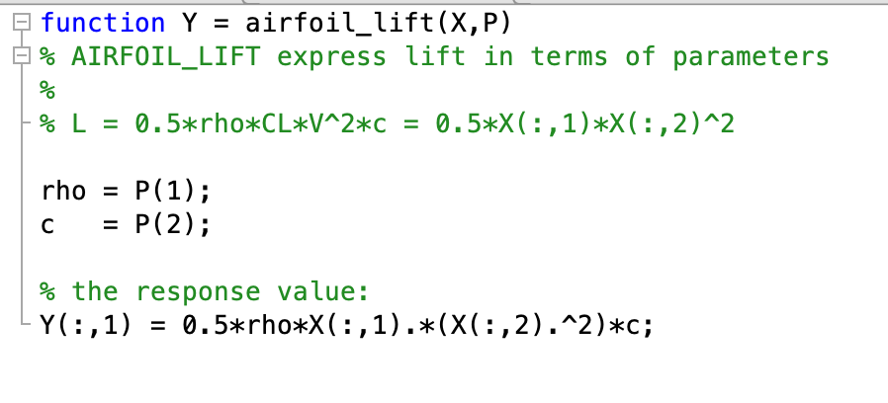
Exercise 1: sensitivity of airfoil lift
Run a simple ‘airfoil lift’ test case with following model and random variables:
P(1) and P(2) are two model parameters (deterministic)
V => X(1) and C_{L} => X(2) are two random parameters for which we want to compute sensitivities.
To run ‘airfoil_lift’, modify ‘testSensitivity.m’ by changing caseName = ‘airfoil_lift’
Question: which method is your favorite? Why?

Slide 17
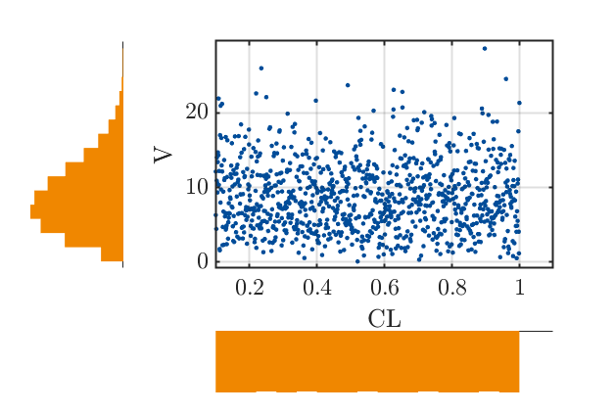
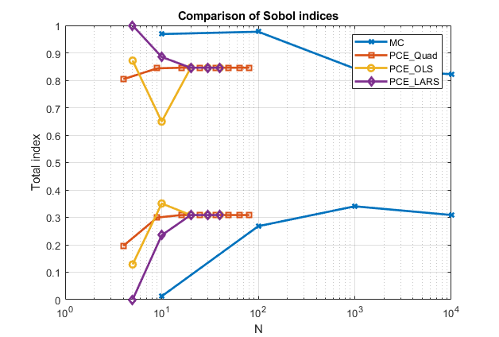
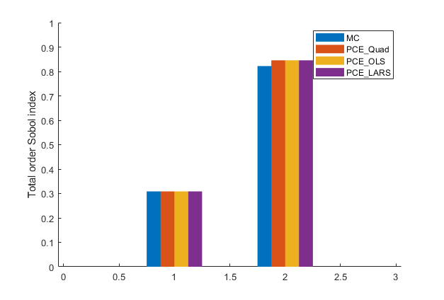
Discussion of results
V
CL
CL
V
Marginals of input parameters
Convergence of sensitivity indices with number of samples
Comparison of methods

Slide 18
Part II Sensitivity analysis ECN AeroModule

Slide 19
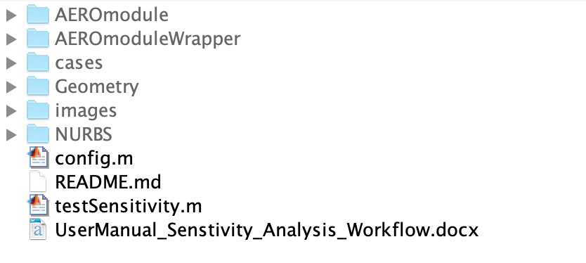
Structure
Main routine to run sensitivity analysis.
We only change variable ‘caseName’ in this routine

Slide 20
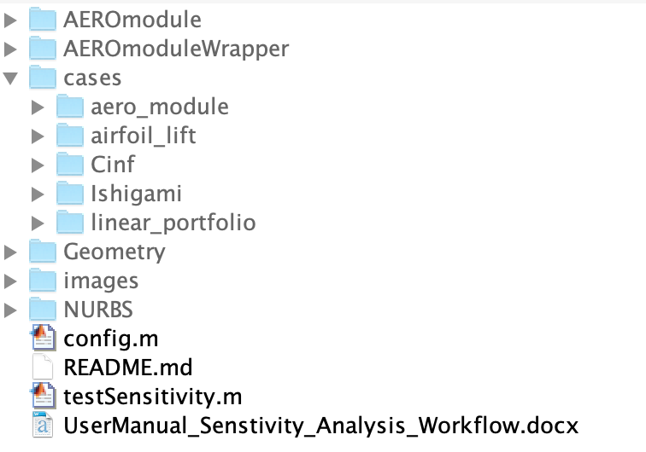
cases
Contains different test cases; we are interested in aero_module directory

Slide 21
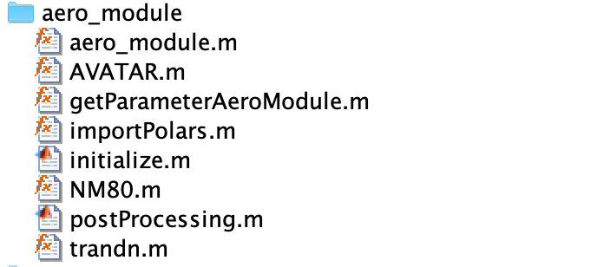
aero_module
Routines containing turbine data and uncertainty description

Slide 22
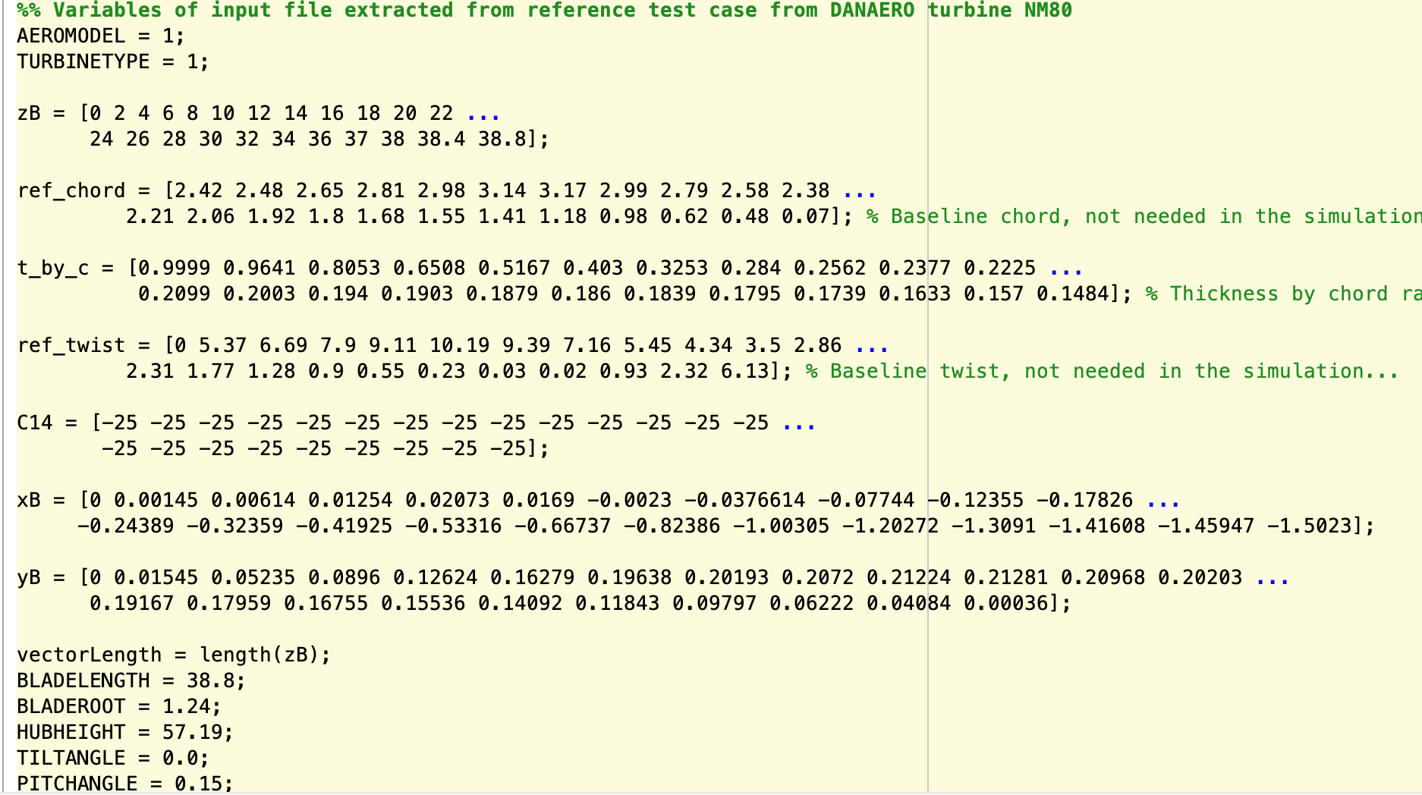
NM80.m
Has two parts:
1 . Deterministic part
extracted from “input.txt” file
2. Stochastic part to describe
probability distribution of
random parameters

Slide 23
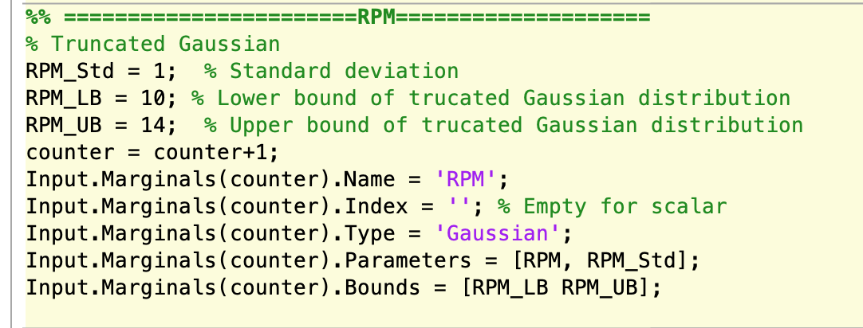
Adding an input parameter
Random variable should be described in UQLab format, for example, truncated Gaussian for RPM is defined as follows:

Slide 24
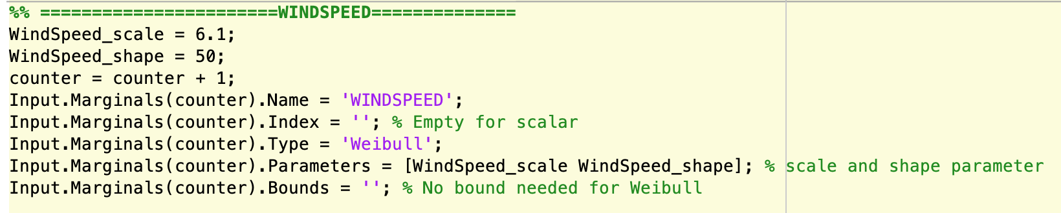
Adding an input parameter
Weibull distribution for wind speed
New input parameter can be added anywhere in NM80.m as the order in not important

Slide 25
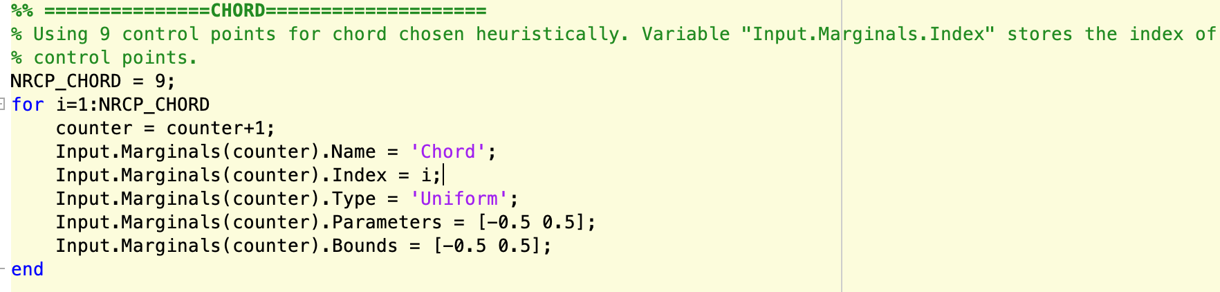
For vector input parameters
For vector parameters, such as chord and twist, each control point is treated as a random input

Slide 26
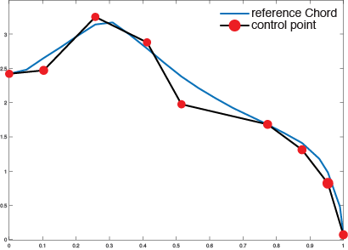
Parameterization of chord/twist/…
This needs to be done separately

Slide 27
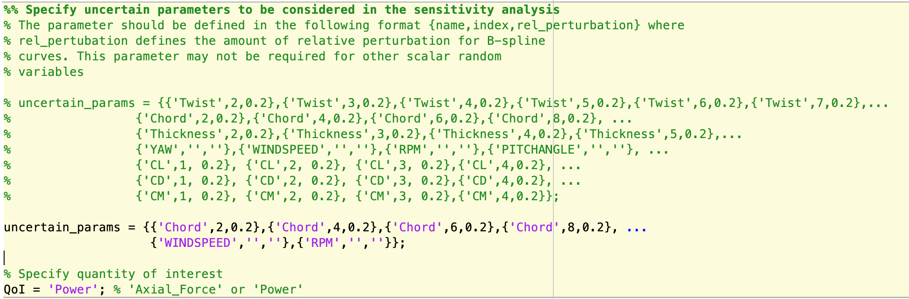
Choosing parameters for SA
A list of all possible parameters
Few selected from the list

Slide 28
aero_module
Routine for describing sensitivity analysis related options

Slide 29
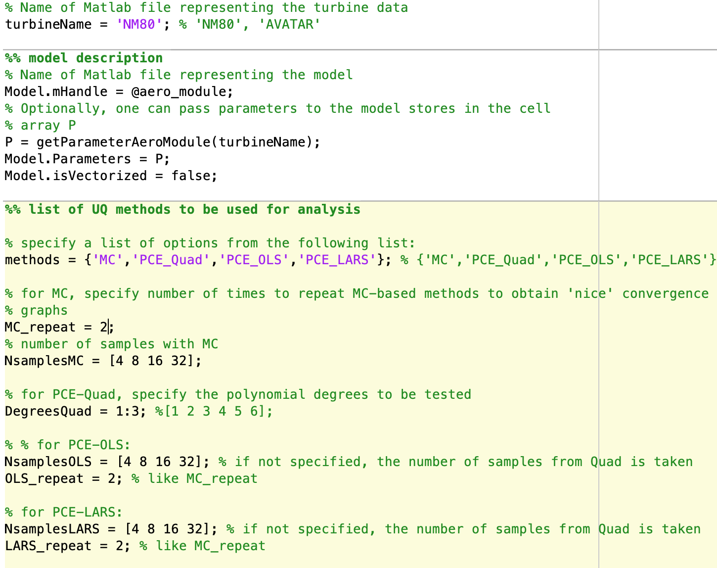
initialize.m
Turbine data filename
Four methods to compute sensitivity
Parameters for different methods

Slide 30
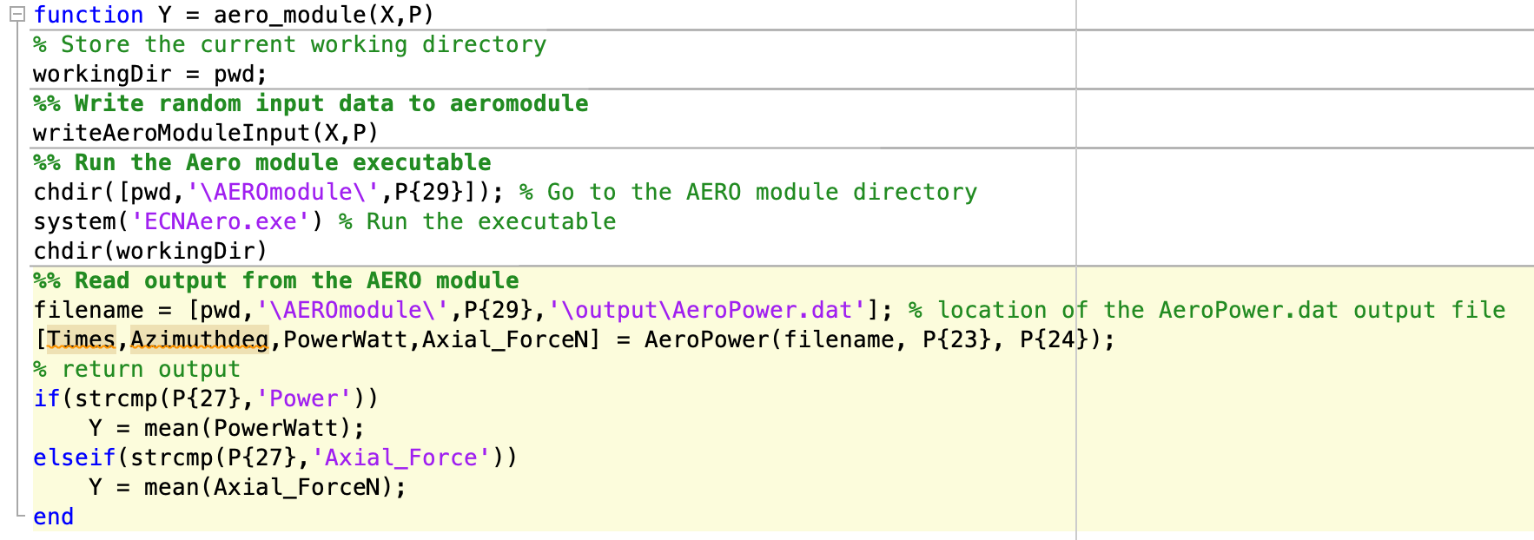
aero_module.m
This routine run the AERO-module package and reads the output quantity, power and axial force
Four methods to compute Sensitivity

Slide 31
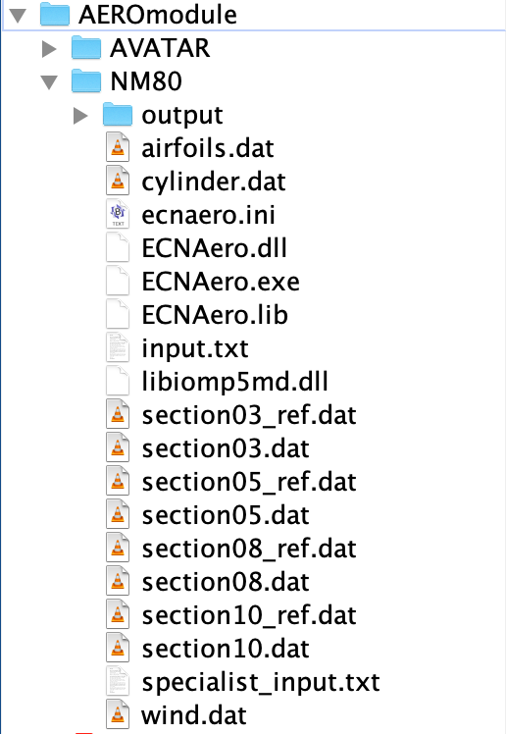
Setting up Aero-module
Directory should have same name as the turbine
Make a copy of reference polar files

Slide 32
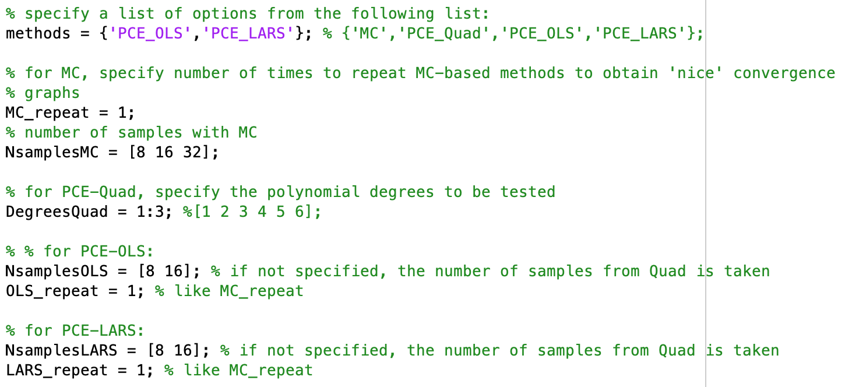
Exercise 2: SA of operational parameters for Power
1. Changes in NM80.m file
2. Changes in initialize.m
3. Modify ‘testSensitivity.m’ by changing caseName = ‘aero_module’ and run it

Slide 33
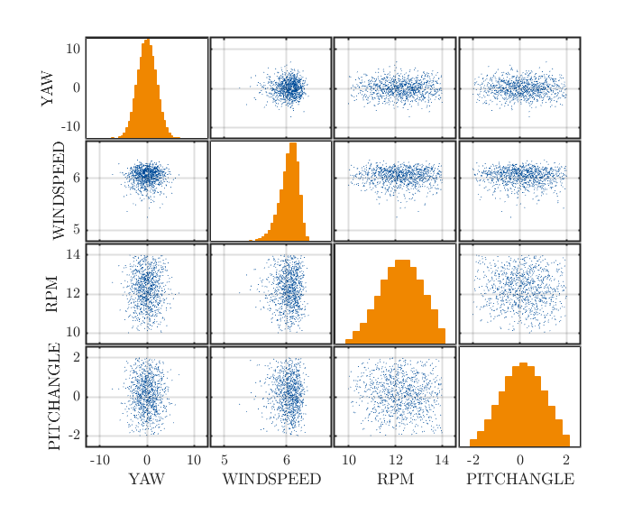
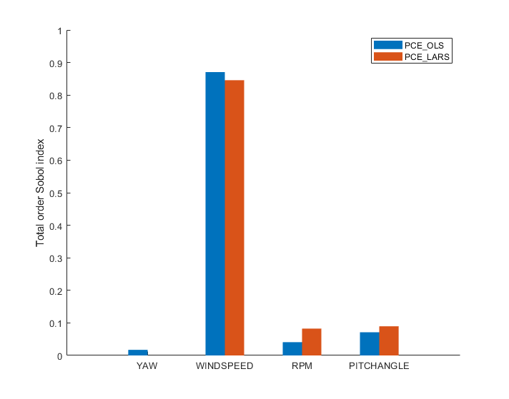
Output

Slide 34
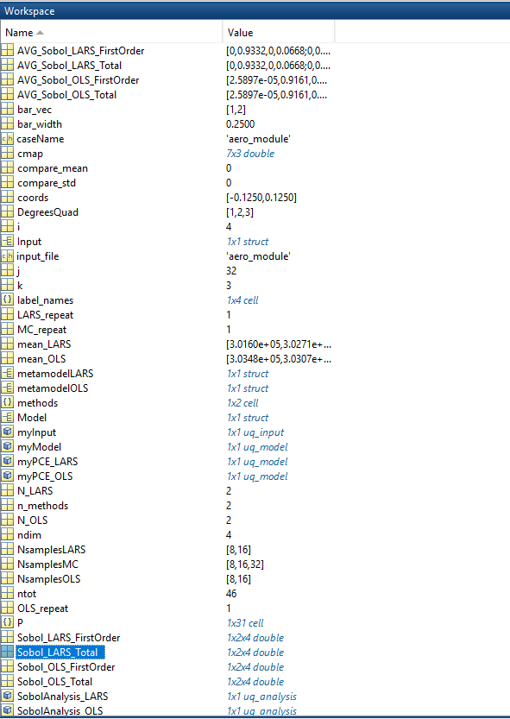
Output Variables
Sobol_LARS_Total contains Sobol indices for runs with different number of samples
AVG_Sobol_LARS_Total contains averaged Sobol indices w.r.t number of repetitions (LARS_repeat). These are plotted in the histogram (see PostProcessing.m)
Mean and standard deviation of the quantity of interest is stored in variables: mean_LARS, std_LARS

Slide 35
Part III Miscellaneous topics

Slide 36
Exercise 3: Change turbine and add uncertainty
Run SA for ‘AVATAR’ turbine
Add PITCHANGLE as a new input parameter in SA
Truncated Gaussian distribution with mean =PITCHANGLE, Std=1, LB=-2,UB=2
Use two methods, PCE_LARS and PCE_OLS
Discuss the result and verify that SA is correct?

Slide 37
If you are interested…
Parameterizing a curve using B-splines, different approach for polars and chord, twist
Vector as output quantity
Adding more model parameters in the analysis

